Slide 1

FWW
Centenary
Programme
CLAUDIA KENYATTA
HEAD OF CEREMONIALS & FIRST WORLD WAR COMMEMORATIONS
DEPARTMENT FOR CULTURE MEDIA & SPORT

Slide 2
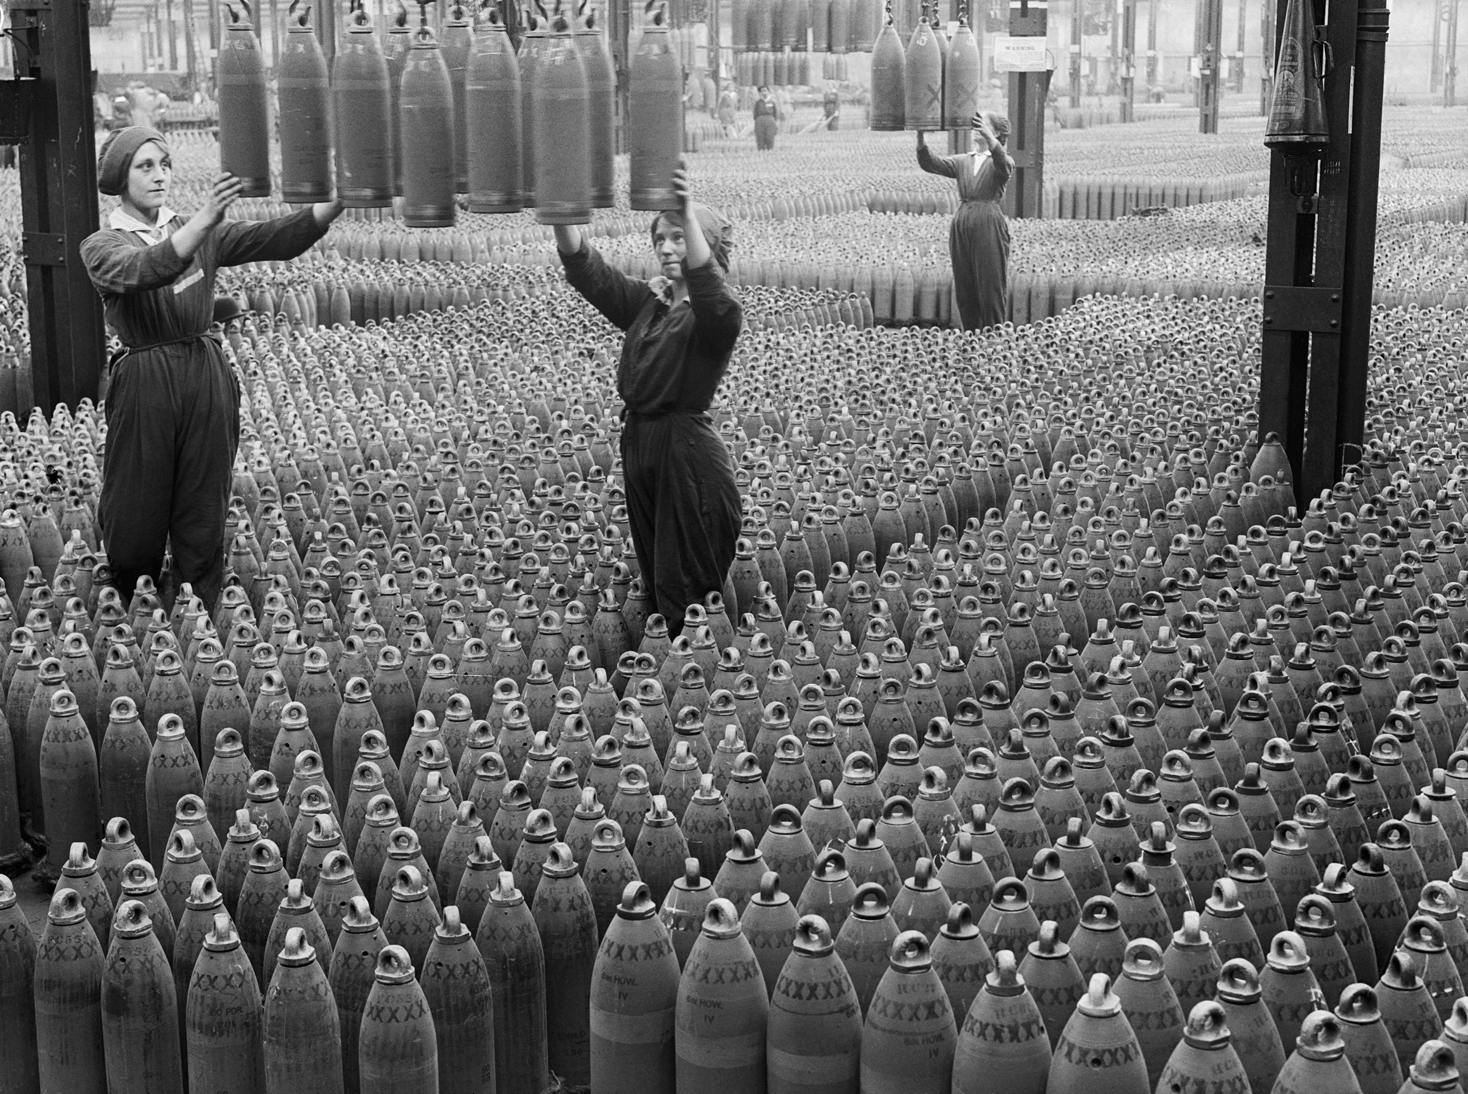
Vision
“Our ambition is a truly national commemoration, worthy of this historic centenary. I want a commemoration that captures our national spirit, in every corner of the country, from our schools to our workplaces, to our town halls and local communities”
David Cameron
IWM London
October 2012
© Crown Copyright IWM.

Slide 3
Why Commemorate the Centenary?
The scale of the sacrifice
The impact of the war on Britain and the world
The First World War as an integral part of the national consciousness
To honour the those who have served and died in combat
To encourage the public to reflect and learn about the war

Slide 4
The Government Programme

Slide 5
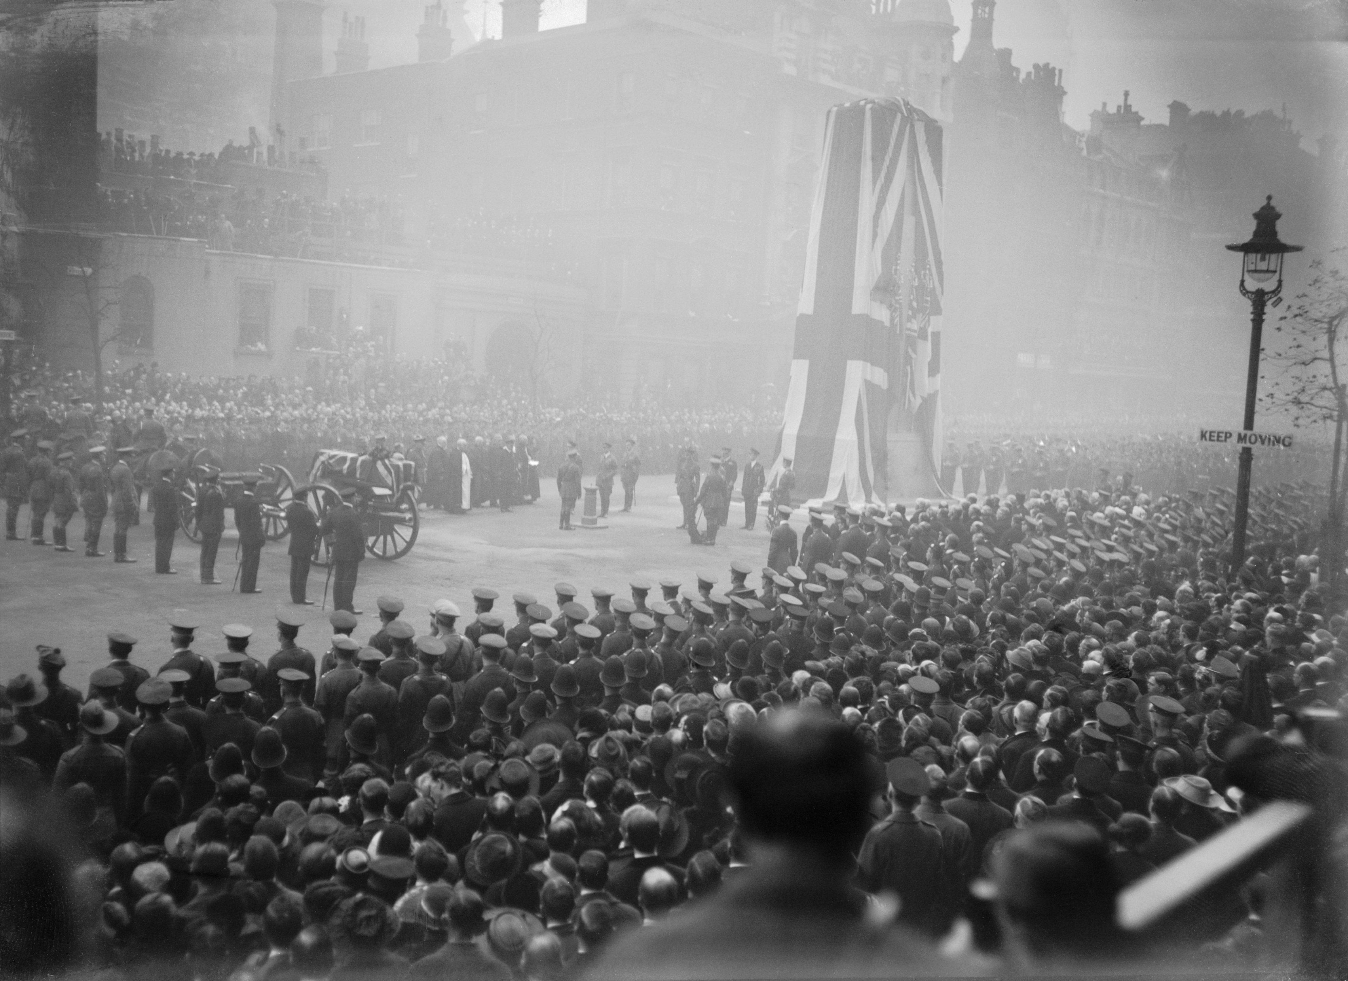
Opportunity
Giving people the opportunity to commemorate and remember the courage and sacrifice of those who served, fought and died during the First World War
© Crown Copyright IWM.

