Slide 1



Slide 2


Slide 3
Feasibility
Budget
Target audience
Fundraising Committee
Format
Capabilities
Analyse event history
Date Selection

Slide 4
Budget / Finances
Budget
Venue
Food & Drink
Entertainment
Staff
Marketing
Audio Visual
Contingency
Sponsorship

Slide 5

Target Audience

Slide 6

Fundraising Committee

Slide 7

Format

Slide 8


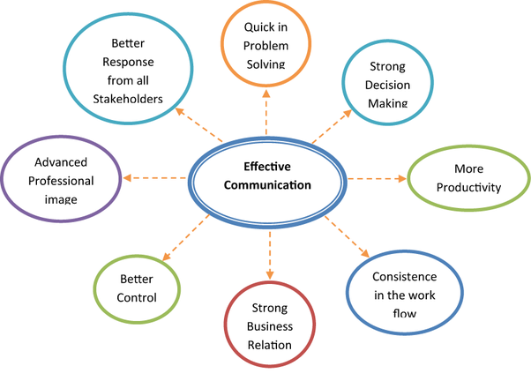


Capabilities

Slide 9
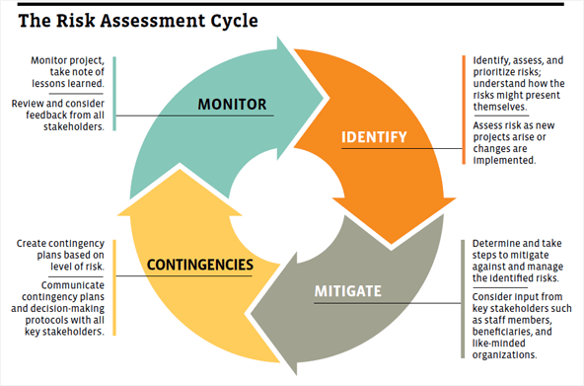
Risk Assessment

Slide 10
Risk Assessment

Slide 12

Press and Media Interest / Publicity

Slide 13


Slide 14


